Slide 1
Classroom Rules and Procedures

Slide 2
Welcome Back!
Notes:
🍐 This is a Pear Deck Text Slide
🍐 To edit the type of question, go back to the "Ask Students a Question" in the Pear Deck sidebar.

Slide 3
Classroom Assumptions (AKA Rules)
Be on-time, prepared, and on-task.
You are responsible for your own learning.
Personal electronics are for educational purposes only.
Always be honest and respectful.
Clean up your area and do not damage or draw on any classroom property.
No behavior will be allowed that interferes with the RIGHTS of every student to listen and learn in a safe environment.
Notes:
🍐 This is a Pear Deck Multiple Choice Slide. Your current options are: A: Yes, I will do this!, B: I want to do this but may need some help/reminders., C: I'm going to struggle with these expectations.,
🍐 To edit the type of question or choices, go back to the "Ask Students a Question" in the Pear Deck sidebar.

Slide 4
DON’T BE RUDE.
BE DIFFERENT.
BE NICE.

Slide 5
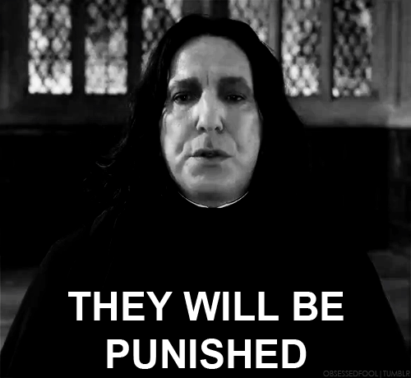
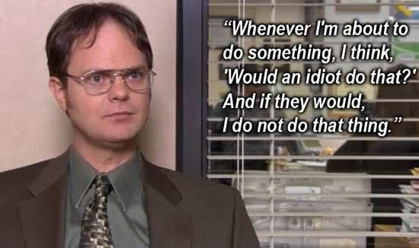
Consequences
Just kidding…no, but seriously.
Failure to comply will be viewed as disruptive behavior:
1st offense = hallway conference with me
2nd offense = parent contact
3rd offense = parent conference
4th offense = removal from classroom to principal’s office for the remainder of class
THIS IS FOR THE ENTIRE SCHOOL YEAR.

Slide 6
CLASSROOM PROCEDURES

Slide 7
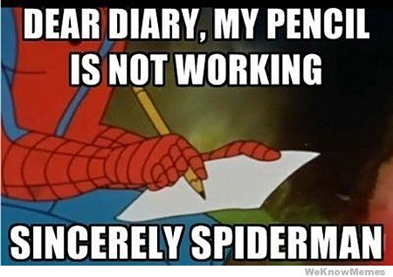
Be Prepared with Materials
Required Materials
Class Filing Folders
Stays in classroom:
College rule notebook
Black or blue pen
Red pen
Pocket folder with 3 prongs (not a binder with metal rings)
12-pack colored pencils
Bring daily:
Personal reading book
Day planner
Your class period is assigned a file cabinet drawer. You will keep your materials in individual hanging folders, arranged alphabetically.

Slide 8
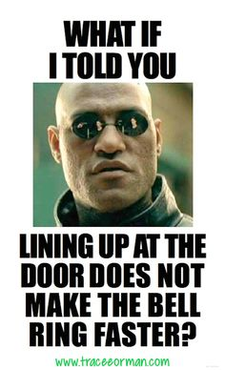
Entering & Exiting the Classroom
Entering
Exiting
Grab materials from your class file folder.
Check the board for bell work and schedule
Sit at your assigned desk and begin bell work, silently.
If you have not begun bell work when the bell rings, you will be marked tardy.
After entering, Students may not leave without permission.
Tardy? Sign the Tardy Log.
I will instruct you when to pack up materials, row by row.
You must clean around the desks before being dismissed.
Sit in your assigned seats until dismissed.

Slide 9
Bell Work & Reading
Bell Work
What to do when finished?
There will be a bell work assignment on the board EVERY DAY.
Begin the bell work before the bell rings.
Complete bell work in your Writer’s Notebook unless instructed otherwise.
Be prepared to share.
When you are finished with bell work, read your personal reading book until I begin class.
No reading = Disciplinary
action
Paper vs. Phone/Kindle

Slide 10
Personal Belongings
Bags & Stuff
Food & Drink
Small bags or other personal belongings are to be kept in your locker, per Mr. Gustaveson’s and Mr. Bergeson’s directions.
I don’t care if you chew gum. DO NOT STICK IT ANYWHERE!!!
Water bottles are great.
Snacks are allowed, if you clean your desk with Lysol wipes before leaving.

Slide 11
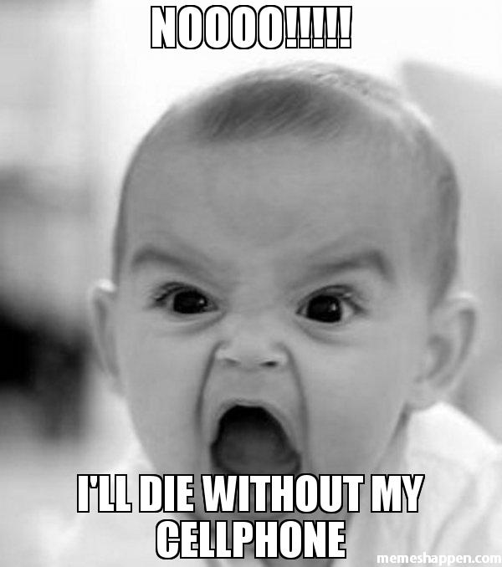
Electronics & Toys
Cellphones
iPods/Earbuds
Put it on silent or vibrate. If I hear it, you will be given 1 warning.
If you are using it when you shouldn’t, I will take it for the remainder of the day.
If I take it again, your parent can pick it up from Mr. Bergeson.
School policy = no earbuds seen or heard.
Occasionally, I will have you use them for an assignment.
Fidget Spinners/Cubes/Toys/Etc
NO…just no.

Slide 12
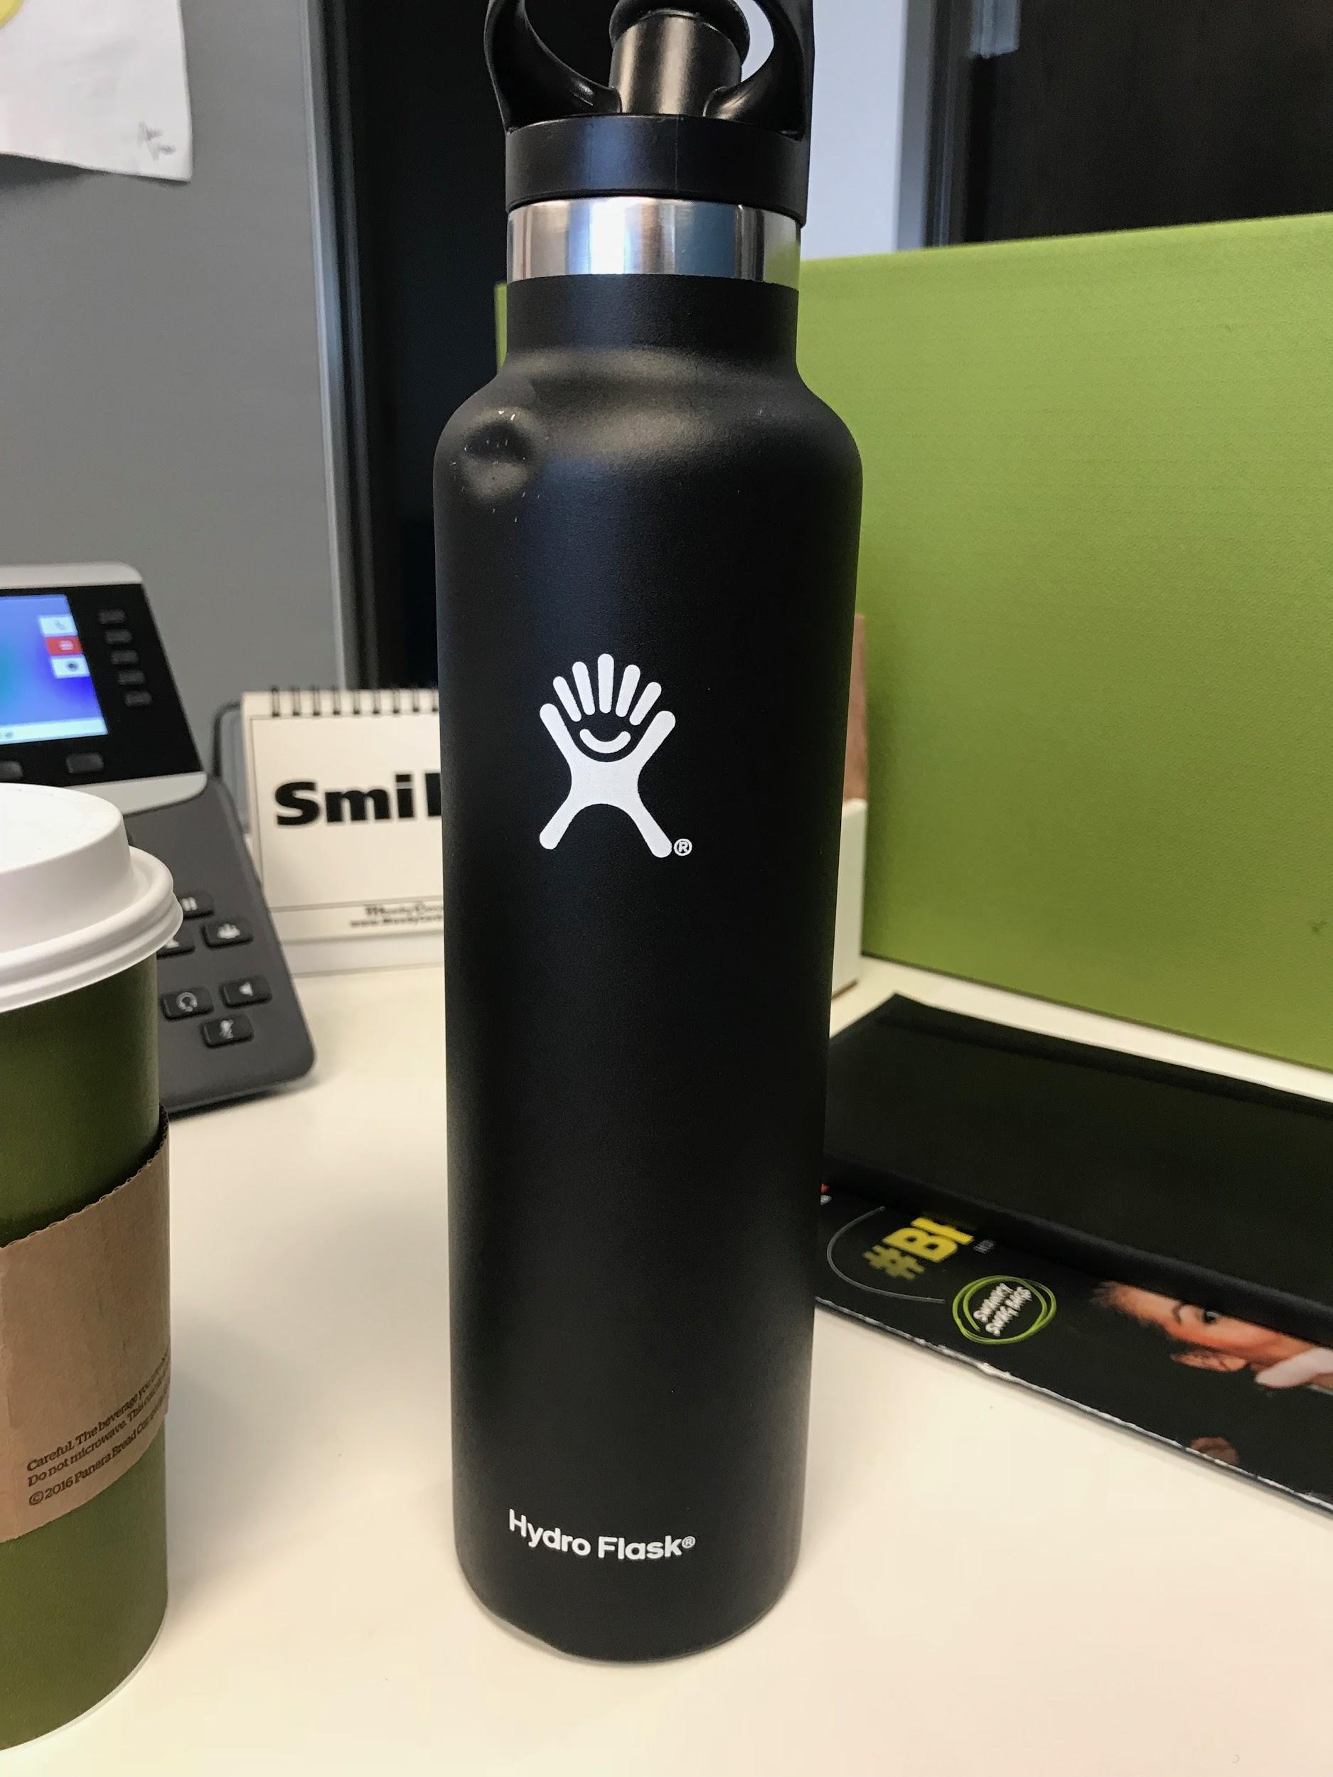
Restroom & Water
Restroom
Water
USE THE RESTROOM BEFORE CLASS.
After entering class, students will not be allowed to leave unless it is an emergency.
You have 4 emergency passes until Christmas.
If it is an emergency you must give me your electronic devices, get your hall pass hole punched by me, and sign the Hall Pass Tracker.
Students should get water before class or bring a water bottle to class.
Notes:
🍐 This is a Pear Deck Number Slide
🍐 To edit the type of question, go back to the "Ask Students a Question" in the Pear Deck sidebar.

Slide 13
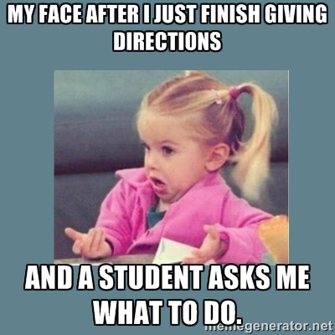
Pencil Sharpening & Trash
Pencil Sharpening
Trash
Students are to sharpen pencils upon entering the classroom.
If your lead breaks and you have no replacement, ask a neighbor. Then raise your hand and wait for the instructor.
DO NOT GET UP DURING A LESSON!!!
Trash can be thrown away when you are dismissed from class. Keep it at your desk until you are dismissed.
Pick up all trash around your desk before leaving.

Slide 14
Turning in Your Assignments
Turning in Work
Late Work
Pass work to the end of your row when I ask for it. I will collect them and place them in your class tray.
Turned-in work goes in the TOP tray; I will put corrected work in the bottom tray.
If you need help on any work, come see me before/after school or sign up on my PAWS list. I do not have PRIDE this year.
I will only grade work that is 100% completed. I will return partially completed work with no grade.
Students missing work will be automatically assigned to PAWS.
Late work will be accepted up to one month after due date.

Slide 15
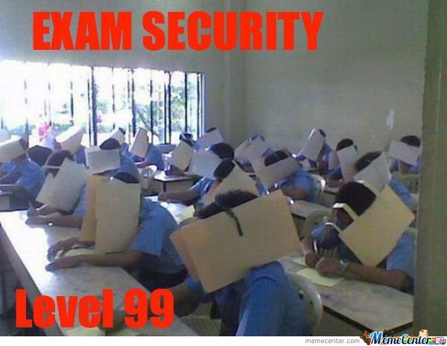
Cheating & Plagiarism
Cheating is turning in anything that your own brain did not create.
1st offense: Redo for up to 75% credit
Following offenses: No credit, no redos.

Slide 16
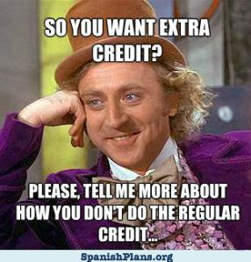
Extra Credit
I do not offer extra credit.
You may redo any work that did not receive 100%.
You can receive Bell Work Passes for completing extra library research questions.

Slide 17
Papers
Paper Headings
Paper Usage
ALL work must have the following heading:
First name Last name
Period ___
Pencil or blue/black pen.
Write on the front and back of the pages in your Writer’s Notebook.

Slide 18
Instructional Time
Instructor Lessons
Group/Independent Work
Students should be silent and attentive during any lessons or presentations.
If you have a RELEVANT comment or question, raise your hand.
DO NOT LEAVE YOUR SEAT WHILE I AM SPEAKING.
During group work, students may move to join their groups. Stay with your group. DO NOT wander the classroom or talk to friends outside your work group.
During independent work, you are free to sharpen your pencil or use the Student Station. DO NOT wander the classroom or talk to friends.
Work finished? Read your book or work on any homework from any class.

Slide 19
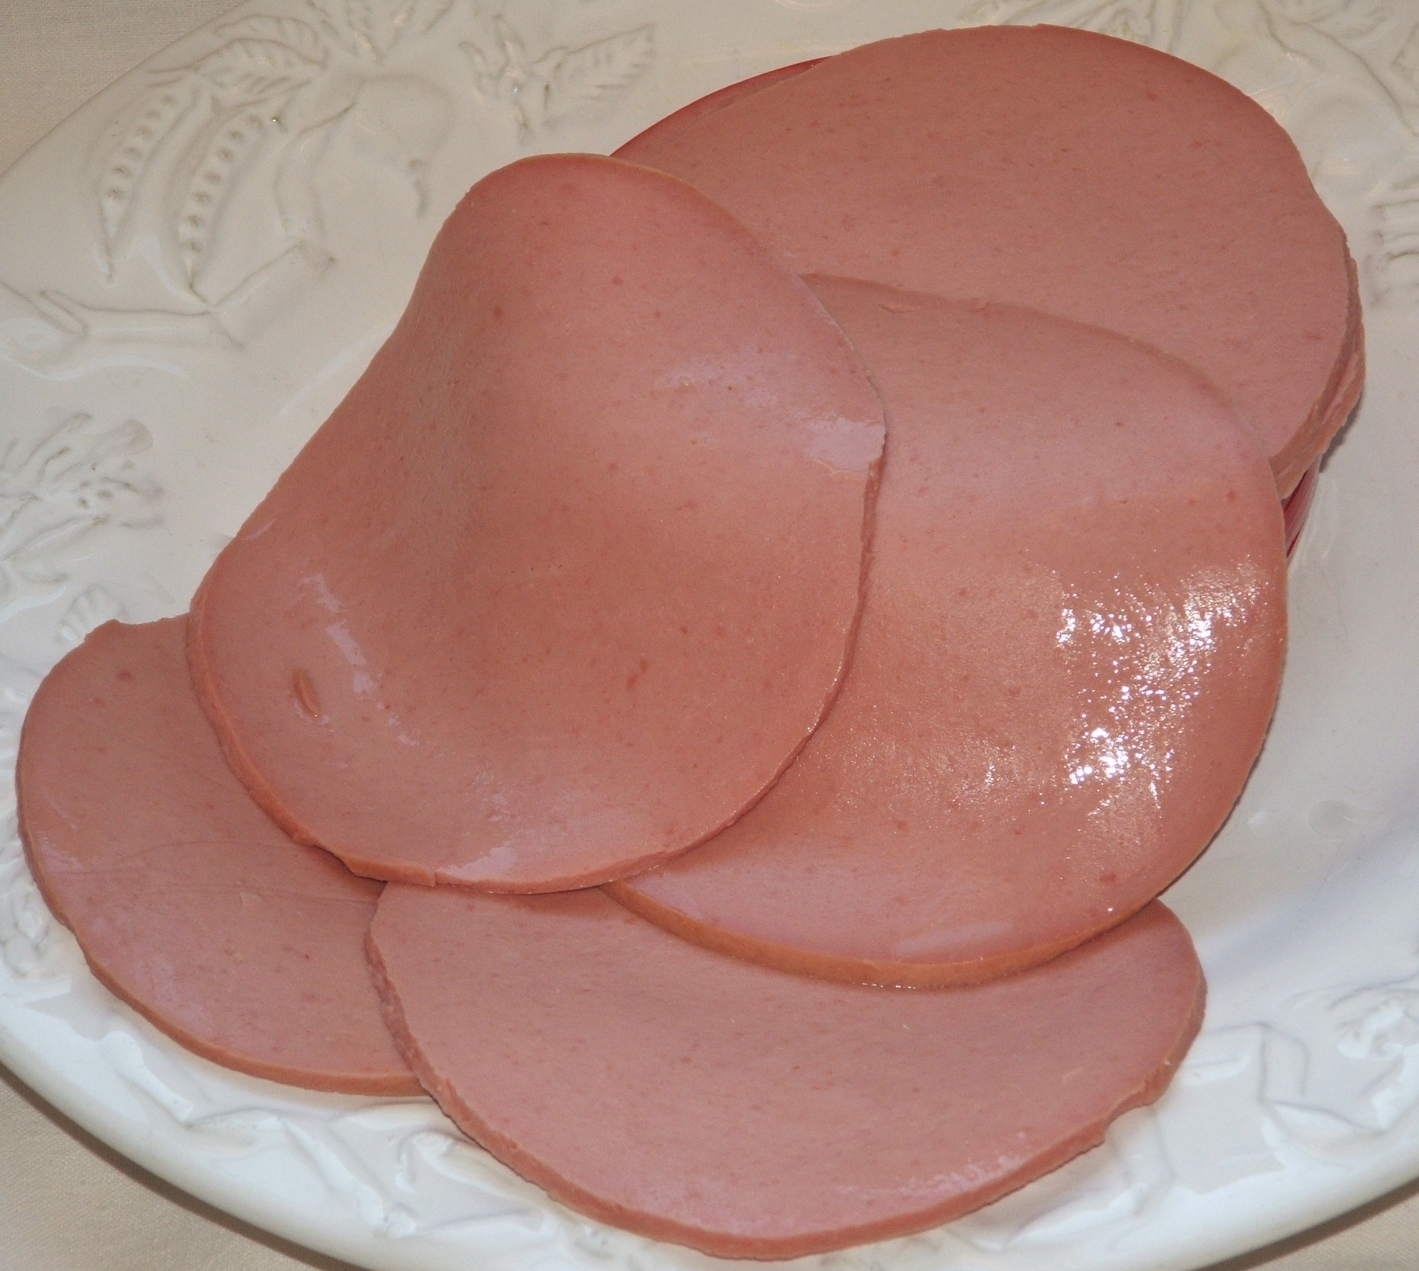
Attention, Please!
I say...
You respond...
“S A L A ME”
t n o t
o d o
p k
“BOLOGNA”

Slide 20
Walking in the Hallways as a Class
We will occasionally go to the library or computer lab as a class. Students will be excused by rows, and are to SILENTLY walk to the side of the hallways.
There will be NO TALKING.
All classroom rules still apply in the hallway, library, and computer lab.

Slide 21
Cotnact Info
Email: camille.sylvester@washk12.org
Website: www.sylvestersstudyhall.weebly.com
Zoom: https://zoom.us/j/8237692461

Slide 22
EMERGENCY PROCEDURES

Slide 23
Types of Emergencies

