Slide 1
Method for writing a constructed response:
It's a RACE!
R - Reword the question with key words
A - Answer the question (thesis statement)
C - Citing Evidence (x2) and Clarifying (logical reasoning)
E - Ending the Response
Julie Faulkner, TPT

Slide 2
Practice the RACE
R - Reword the question with key words
A - Answer the question (thesis statement)
C - Citing Evidence (x2) and Clarifying
E - Ending the Response
Prompt: Does Joe like the busy winter season? (Pretend you read a story about Joe called "Winter Fun").
Response: Winter is busy time of year. Joe actually likes winter very much. The story says, "Joe enjoyed feeling the icy cold winter on his cheeks." The story also says that skiing and cold air are things he is only likely to encounter during the winter. Therefore his enjoyment of these things must mean that he also enjoys the winter season. All in all winter is an enjoyable season for Joe.
Julie Faulkner, TPT
Notes:
Note for Slide 3:
It's important to pull out the key word from the prompt to make the topic sentence (red).

Slide 3
Prompt Practice: Read the Stimulus First. Then respond in complete paragraph form. Cite from the stimulus.
Prompt: What is Joe's mood as he is up to bat? Use at least two examples of supporting evidence to explain your response.
First Base
Woooosh! "Strike two!" the umpire called. I stepped back out of the batter's box and hung my head. Just a hit, that's all I want. I swung the bat a couple of times to loosen up, and took my place again near the plate. With my heart beating throbbing in my ears, I raised the bat over my shoulder and waited. The pitcher pulled back and let the ball fly. I watched it speed toward me and... SMACK! I dropped the bat and ran to first. Safe! First base!
Stimulus is the source
Julie Faulkner, TPT
Notes:
Joe's mood changed when he got up to bat. His mood became nervous and worried. The passage says that Joe's heartbeat was "throbbing in his ears." Another example of how he was worried was that he "hung his head" as he waited. All in all, Joe was nervous when it was his turn to bat, but he hit the ball and made it to first base.

Slide 4
Prompt Practice: Read the Stimulus First. Then respond in complete paragraph form. Cite from the stimulus.
In the passage titled "First Base,” Joe's mood changed when he got up to bat. His mood became nervous and worried. The passage says that Joe's heartbeat was“ throbbing in his ears.“ Another example of how he was worried was that he "hung his head" as he waited. All in all, Joe was nervous when it was his turn to bat, but he hit the ball and ultimately made it to first base.
Prompt: What is Joe's mood as he is up to bat? Use at least two examples of supporting evidence to explain your response.
Julie Faulkner, TPT

Slide 5
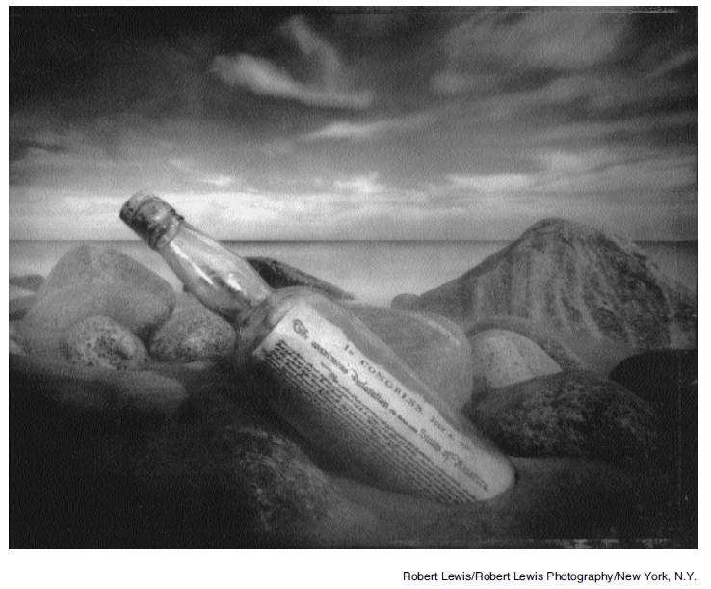
Prompt #1: Read the Stimulus First. Then respond in complete paragraph form. Cite from the stimulus.
What mood is present in the image? Show me how you know by citing at least two elements of the setting from the image to support your answer. Use RACE.
Julie Faulkner, TPT

Slide 6
Sample
The word mood refers to the feeling or atmosphere present in a work of art. In this image by Robert Lewis there is a sense of loneliness. The image of the bottle washed up on the seashore seems isolated and sad. This mood is also connected to the bottle's contents. The rolled up copy of the Declaration of Independence in the bottle reminds the audience how isolated American colonists were from the rest of the world and how alone they must have felt when they went against the king all by themselves without any foreign allies to help them. The mood here is clearly a lonely one.
Julie Faulkner, TPT
Notes:
It would be good practice here to color edit this sample with students.

Slide 7
Sample
The image by Robert Lewis displayed here exhibits an
intriguing mood. The mood here depicted is daring. To send
a message in a bottle is adventurous and unconventional, but
to send such an important document in such a bold and
uncertain way definitely lends to the audacity of the notion.
The glimpse of the Declaration of Independence through the
glass evokes the sense of bravery and determination that our
forefathers must have had to dare to challenge so formidable
a foe as the king of Britain. Therefore, the mood of this
image is one that is bold.
Julie Faulkner, TPT

